Slide 1
DATA SCIENCE PROJECT
Uber Ride Analytics
Exploratory Analysis, Feature Engineering & Fare Prediction Modeling
1,156
4
90.6%
RIDE RECORDS
ML MODELS COMPARED
BEST R² SCORE
Prepared from Jupyter Notebook Analysis • Python • Pandas • Scikit-learn

Slide 2
PROJECT OVERVIEW
From Raw Ride Logs to a Fare Prediction Engine
This project takes a raw Uber ride-history export and walks the full data-science pipeline: cleaning the data, engineering new features, exploring ride patterns visually, building a fare-estimation formula, and training multiple regression models to predict ride fares.
1
Data Cleaning
OBJECTIVE
Remove duplicates, impute missing PURPOSE values, fix date/time types
Understand how distance, timing and trip type drive Uber ride fares — and build a model accurate enough to estimate the fare of a brand-new, unseen ride.
2
Feature Engineering
Round-trip flag, month, day-part (Morning/Afternoon/Evening/Night), ride duration
3
Exploratory Analysis
Visualize patterns across time, location, category & purpose
4
Predictive Modeling
DATASET: UberDataset.csv • 1,156 rides • Jan–Dec 2016
Train & compare 4 regression models to estimate ride fares
02

Slide 3
THE DATASET
1,156 Uber Rides Across a Full Year
The raw export (UberDataset.csv) logs every ride with a start/end timestamp, category, origin, destination, distance and stated purpose.
1,156
7
RAW COLUMNS
START_DATE / END_DATE
Timestamp the ride began / ended
TOTAL RIDE RECORDS
ORIGINAL COLUMNS
CATEGORY
Business or Personal
START / STOP
Origin & destination city
177
93%
MILES
Distance travelled
PURPOSE
Stated reason for the ride
UNIQUE START CITIES
RIDES TAGGED ‘BUSINESS’
03

Slide 4
STEP 1
Cleaning & Preparing the Data
1
Duplicates Removed
2
Missing Values Handled
Checked the full dataset for duplicated rows and dropped them before any analysis began.
PURPOSE had the most gaps — missing entries were imputed as “Not mentioned” rather than dropped, preserving every ride record. A stray totals row at the end of the file was also removed.
3
Data Types Fixed
4
Text Inconsistencies Fixed
START_DATE and END_DATE were stored as text; converted to proper datetime objects so they could power time-based features.
Corrupted city name encoding (“Kar?chi”) corrected to “Karachi” in both START and STOP fields.
04

Slide 5
STEP 2
Engineering New Features
New fields were derived from the raw timestamps and locations to unlock deeper analysis and give the ML models richer signal.
ROUND_TRIP
DATE / TIME
DAYTIME
Flags whether START and STOP locations match (yes/no)
Split from START_DATE for daily & hourly analysis
Hour binned into Morning, Afternoon, Evening, Night
MONTH
WEEKDAY
MINUTES
Numeric month mapped to Jan–Dec labels
Day name extracted for weekly ride patterns
Ride duration = END_DATE − START_DATE
05

Slide 6
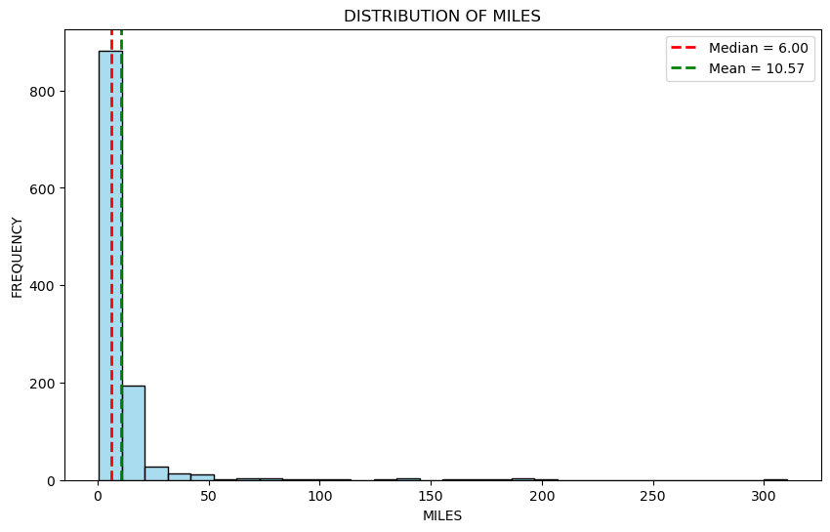
EXPLORATORY ANALYSIS
How Far Do Rides Typically Go?
Most rides are short: distance is heavily right-skewed with a long tail of a few very long trips.
The median distance sits well below the mean, confirming that a handful of long-haul rides pull the average up.
This skew is a key reason tree-based models (which handle non-linear splits well) end up outperforming a simple linear fit.
06

Slide 7
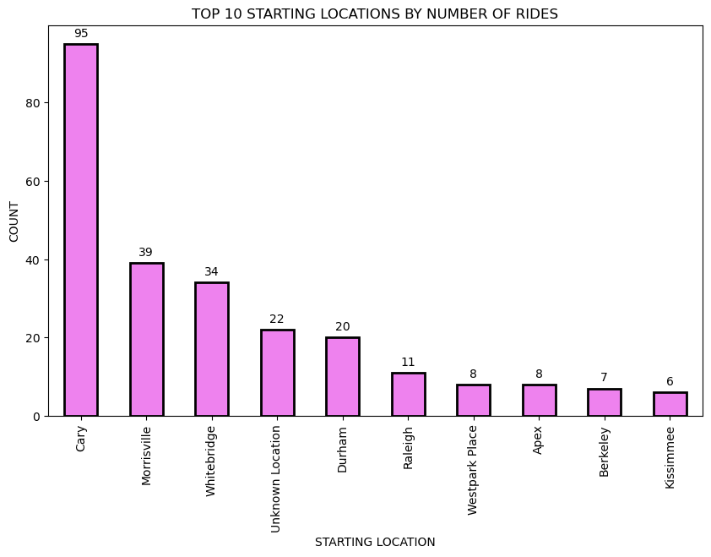
EXPLORATORY ANALYSIS
One City Dominates the Ride Log
CARY, NC LEADS
201
rides started in Cary — the single busiest origin city, out of 177 unique starting points.
Ride activity is heavily concentrated: a small cluster of cities (Cary, Morrisville, Whitebridge, Islamabad) account for a disproportionate share of both pickups and drop-offs, while the long tail of 170+ other cities each contribute only a handful of rides.
07

Slide 8
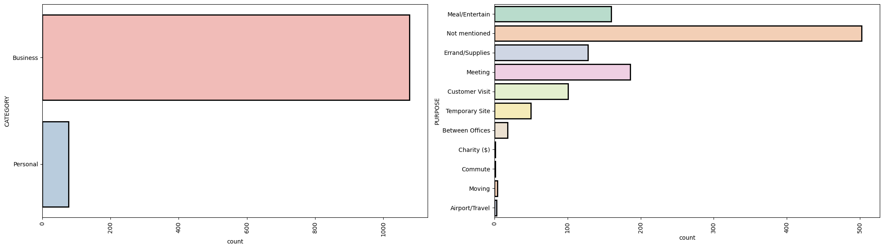
EXPLORATORY ANALYSIS
What Are These Rides For?
Business trips overwhelmingly dominate the CATEGORY field, and among stated purposes, “Meeting” and “Meal/Entertain” are the most common — consistent with a rider using Uber mainly for work-related travel.
08

Slide 9
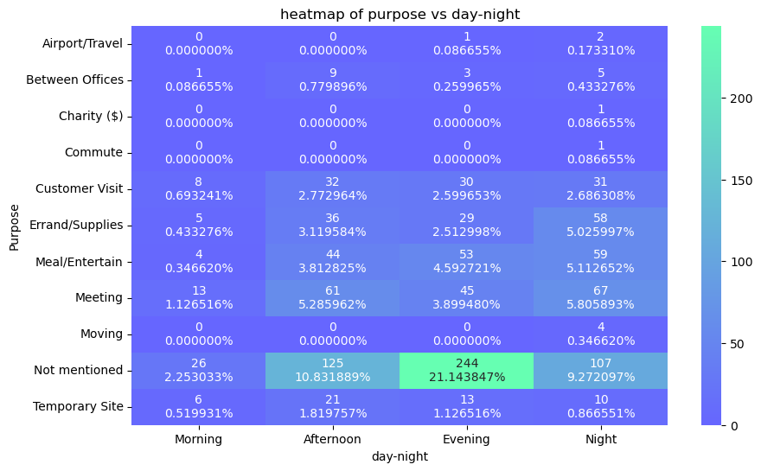
EXPLORATORY ANALYSIS
Ride Purpose Shifts Across the Day
Morning
Errand & supply runs dominate early hours
Afternoon
Meetings and customer visits peak
Evening
Meal/Entertain rides climb sharply
Night
Airport & temporary-site trips more common
09

Slide 10
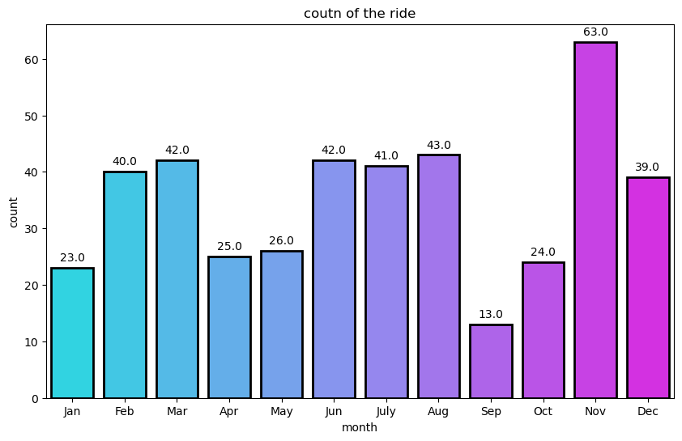
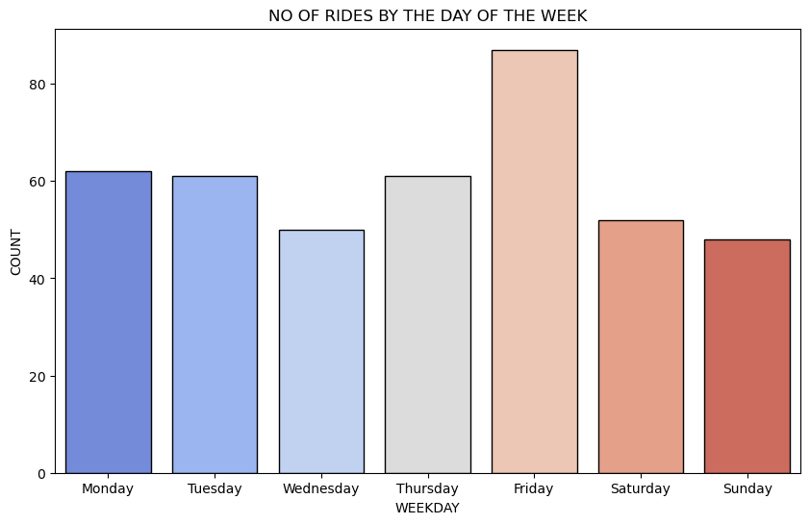
EXPLORATORY ANALYSIS
Seasonal & Weekly Ride Rhythms
RIDES BY MONTH
RIDES BY WEEKDAY
10

Slide 11
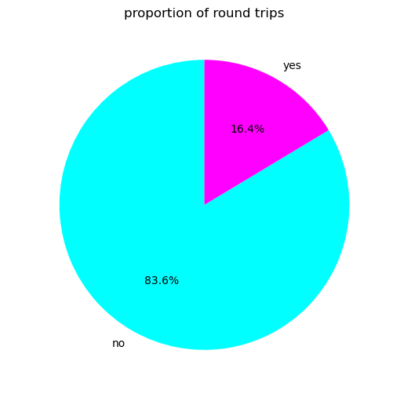
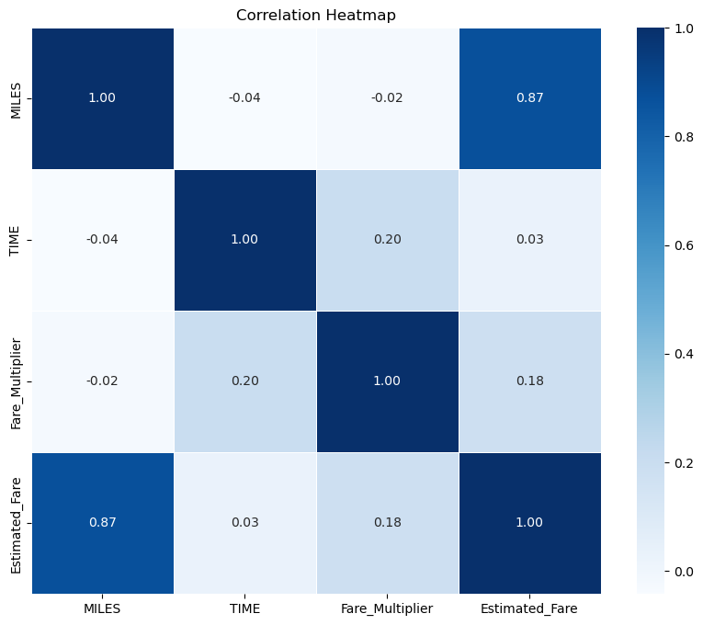
EXPLORATORY ANALYSIS
Trip Structure & Feature Relationships
ROUND-TRIP SHARE
CORRELATION HEATMAP
The large majority of trips are one-way. MILES correlates most strongly with the engineered Estimated_Fare, validating distance as the primary fare driver used in modeling.
11

Slide 12
STEP 3
Building a Ground-Truth Fare Formula
Since the raw data has no fare column, a rule-based Estimated_Fare was engineered from distance, time-of-day and trip type — giving the ML models a real target to learn.
Estimated_Fare = (Base Fare + Miles × Rate per Mile) × Time Multiplier × 2 if Round Trip
Base fare: $2.00 Rate per mile: $5.00
MORNING
AFTERNOON
EVENING
NIGHT
× 1.00
× 2.00
× 2.50
× 1.00
Evening rides carry the highest multiplier (peak demand pricing), while round trips simply double the one-way estimate. This engineered target becomes the label the regression models are trained to predict.
12

Slide 13
STEP 4
Training the Prediction Pipeline
INPUT FEATURES
FOUR MODELS COMPARED
MILES — ride distance
Linear Regression
DAYTIME — encoded 1–4
Baseline linear fit between features and fare
ROUND_TRIP — 0 or 1
Decision Tree
Learns non-linear splits in distance & timing
Fare_Multiplier — time-based rate
Random Forest
TARGET VARIABLE
Ensemble of trees for robustness & accuracy
Estimated_Fare
K-Nearest Neighbors
80 / 20 train–test split • random_state = 42
Predicts from the 5 most similar past rides
13

Slide 14
RESULTS
Model Performance on the Test Set
Model | MAE | RMSE | R²
Linear Regression | 29.51 | 73.37 | 0.906
Decision Tree | 26.48 | 158.15 | 0.564
Random Forest | 19.53 | 110.25 | 0.788
K-Nearest Neighbors | 26.07 | 138.32 | 0.666
BEST FIT ON HELD-OUT TEST DATA
Linear Regression — R² 0.906
Because Estimated_Fare was engineered as a linear formula of these exact features, a linear model fits it almost perfectly on the test split.
14

Slide 15
VALIDATION
Stress-Testing on Brand-New Rides
Beyond the train/test split, each model was scored on 50 freshly simulated rides it had never encountered — a tougher check for true generalization.
KEY TAKEAWAY
Rankings flip on unseen data.
Decision Tree (0.84) and Random Forest (0.83) generalize best to new rides, while Linear Regression drops to 0.67 and KNN struggles most (0.40) — a reminder that a strong test-split score doesn’t always predict real-world robustness.
15

Slide 16
CONCLUSION
Key Insights
1
Distance drives fare
MILES is the strongest predictor — correlation analysis and every model confirm it as the dominant fare driver.
2
Business travel dominates
Over 93% of rides are tagged Business, with Meetings and Meal/Entertain as the leading purposes.
3
Time-of-day matters
Evening rides carry the highest fare multiplier, reflecting peak-time demand pricing.
4
Tree models generalize better
Random Forest and Decision Tree hold up best on unseen data, despite Linear Regression ‘winning’ the test split.
5
Ride activity is concentrated
A small handful of cities (led by Cary, NC) account for a large share of all pickups and drop-offs.
16

